Slide 1
ENTERPRISE DNA - ENVIRONMENTAL DATA REPORTING
THIS REPORT IS DEDICATED TO THE Analysis OF AMBIENT AIR TOXICS
CHALLENGE 17 PROMOTED BY THE ENTERPRISE DNA
AUTHOR – Carlos Cesari Norwich – united kingdom, December 2021

Slide 2
SUMMARY OF KEY FINDINGS: formaldehyde is the most air toxic released into the atmosphere
AIR TOXIC | CONCENTRATION (µg/m3) TOTAL (2005-2018)
1-3 BUTADIENE | 18.2
CARBON TETRACHLORIDE | 128.9
BENZENE | 191.9
ACETALDEHYDE | 277.4
FORMALDEHYDE | 507.7

Slide 3
SUMMARY OF KEY FINDINGS: ELIZABETH SUBURBAN IS TOPING IN 3 AIR TOXICS – Carbon tetrachloride, acetaldehyde and formaldehyde
AIR TOXIC | MOST POLLUTANT LOCATION | CONCENTRATION (µg/m3) TOTAL (2005-2018)
1-3 BUTADIENE | Baltimore Urban And Center City | 2.1
CARBON TETRACHLORIDE | Elizabeth Suburban | 8.8
BENZENE | Pittsburgh Urban And Center City | 20.4
ACETALDEHYDE | Elizabeth Suburban | 46.5
FORMALDEHYDE | Elizabeth Suburban | 60.5
FORMALDEHYDE | New York City Suburban | 60.9

Slide 4
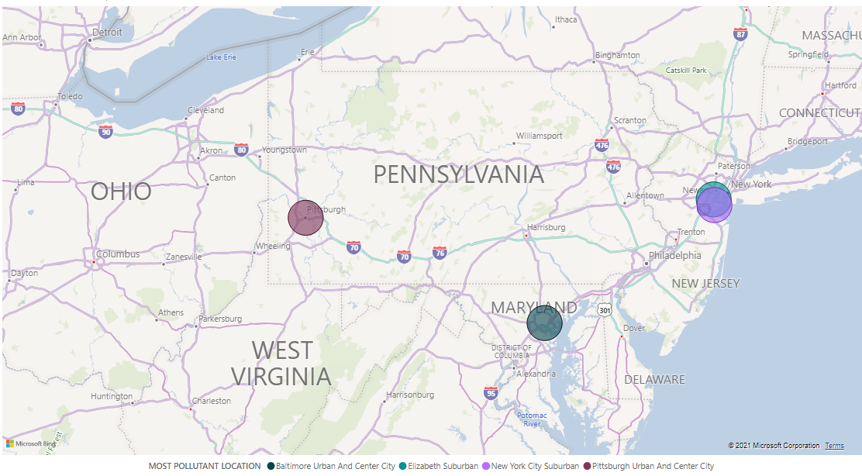
SUMMARY OF KEY FINDINGS: HIGHEST AIR TOXICS LOCATIONS

Slide 5
SUMMARY OF KEY FINDINGS: ACETALDEHYDE TRENDING UPWARDS AND OTHER AIR TOXICS STABLE

Slide 6
SUMMARY OF KEY FINDINGS: 1-3 BUTADIENE TRENDING DOWNWARDS

Slide 7
SUMMARY OF KEY FINDINGS: ACETALDEHYDE TRENDING UPWARDS

Slide 8
SUMMARY OF KEY FINDINGS: BENZENE TRENDING STABLE

Slide 9
SUMMARY OF KEY FINDINGS: CARBON TETRACHLORIDE SLIGHTLY TRENDING DOWNWARDS

Slide 10
SUMMARY OF KEY FINDINGS: FORMALDEHYDE TRENDING STABLE

Slide 11
SUMMARY OF KEY FINDINGS: AIR TOXICS CONCENTRATION OVER PERIOD OF MEASUREMENTS (2005-2018)
LOCATIONS | CONCENTRATION (µg/m3) TOTAL (2005-2018)
Suny Rural | 8.3602
Washington Urban And Center City | 12.7302
Rochester Urban And Center City | 13.6037
Baltimore Suburban | 14.9252
Not In A City Rural NJ | 18.6678
Pittsburgh Urban And Center City | 21.3874
New York City Urban And Center City | 22.3443
Virginia Beach Suburban | 22.3491
Philadelphia Suburban | 22.5965
Not In A City Suburban VA | 22.9959
New York City Suburban | 23.1924
Philadelphia Urban And Center City | 27.6984
Elizabeth Suburban | 46.5339
ACETALDEHYDE (TOTAL ALL SITES 2005-2018) | 277.3851

Slide 12
SUMMARY OF KEY FINDINGS: AIR TOXICS CONCENTRATION OVER PERIOD OF MEASUREMENTS (2005-2018)
LOCATIONS | CONCENTRATION (µg/m3) TOTAL (2005-2018)
Suny Rural | 3.7587
Not In A City Rural PA | 4.0061
Not In A City Rural NJ | 7.0305
Rochester Urban And Center City | 7.9376
Not In A City Suburban VA | 8.9962
New York City Urban And Center City | 10.2758
Beltsville Suburban | 10.3120
Virginia Beach Suburban | 10.4305
Washington Urban And Center City | 11.2770
New York City Suburban | 13.2605
Wheeling Urban And Center City | 13.3334
New York City Suburban | 13.4974
Wilmington Urban And Center City | 13.5839
Baltimore Urban And Center City | 13.8072
Essex Suburban | 14.4153
Elizabeth Suburban | 15.6209
Pittsburgh Urban And Center City | 20.3648
BENZENE (TOTAL ALL SITES 2005-2018) | 191.9080

Slide 13
SUMMARY OF KEY FINDINGS: AIR TOXICS CONCENTRATION OVER PERIOD OF MEASUREMENTS (2005-2018)
LOCATIONS | CONCENTRATION (µg/m3) TOTAL (2005-2018)
Suny Rural | 0.0422
Not In A City Rural NJ | 0.3820
Not In A City Suburban VA | 0.5012
Rochester Urban And Center City | 0.5579
Wheeling Urban And Center City | 0.7351
Beltsville Suburban | 0.8544
New York City Suburban NY | 0.9143
New York City Urban And Center City | 1.0527
Virginia Beach Suburban | 1.1490
Washington Urban And Center City | 1.3514
Pittsburgh Urban And Center City | 1.4005
Wilmington Urban And Center City | 1.6137
New York City Suburban | 1.7313
Elizabeth Suburban | 1.8808
Essex Suburban | 1.8989
Baltimore Urban And Center City | 2.1098
1-3 BUTADIENE (TOTAL ALL SITES 2005-2018) | 18.1752

Slide 14
SUMMARY OF KEY FINDINGS: AIR TOXICS CONCENTRATION OVER PERIOD OF MEASUREMENTS (2005-2018)
LOCATIONS | CONCENTRATION (µg/m3) TOTAL (2005-2018)
Virginia Beach Suburban | 7.2603
Not In A City Suburban VA | 7.3623
Suny Rural | 7.3863
New York City Suburban | 7.7434
New York City Urban And Center City | 7.8678
New York City Suburban | 7.8783
Pittsburgh Urban And Center City | 8.0880
Wilmington Urban And Center City | 8.1211
Rochester Urban And Center City | 8.1938
Wheeling Urban And Center City | 8.2640
Washington Urban And Center City | 8.2946
Baltimore Urban And Center City | 8.3147
Beltsville Suburban | 8.3282
Essex Suburban | 8.3498
Not In A City Rural NJ | 8.7079
Elizabeth Suburban | 8.7628
CARBON TETRACHLORIDE (TOTAL ALL SITES 2005-2018) | 128.9233

Slide 15
SUMMARY OF KEY FINDINGS: AIR TOXICS CONCENTRATION OVER PERIOD OF MEASUREMENTS (2005-2018)
LOCATIONS | CONCENTRATION (µg/m3) TOTAL (2005-2018)
Suny Rural | 17.8001
Rochester Urban And Center City | 24.6966
Pittsburgh Urban And Center City | 29.5373
Not In A City Rural NJ | 30.6387
Virginia Beach Suburban | 39.5196
New York City Urban And Center City | 40.2851
Philadelphia Urban And Center City | 41.2445
Not In A City Suburban VA | 45.7819
Washington Urban And Center City | 58.4094
Philadelphia Suburban | 58.4301
Elizabeth Suburban | 60.4800
New York City Suburban | 60.9100
FORMALDEHYDE (TOTAL ALL SITES 2005-2018) | 507.7332

Slide 16
CONCLUSIONS:
All measurements were taken before the pandemic period.
BENZENE IS THE MOST DANGEROUS AIR TOXIC; IT IS KNOWN HUMAN CARCINOGEN AND THE RESULTS ARE SHOWING A STABILIZATION BUT STILL AT HIGH LEVELS.
ACETALDEHYDE IS SHOWING AN INCREASE AMONGST ALL STATIONS BUT AT ELIZABETH SUBURBAN IS ON AVERAGE DOUBLE THAN THE OTHER STATIONS.
CARBON TETRACHLORIDE IS COMING DOWN SLOWLY IN ALL STATIONS.
1-3 BUTADIENE IS KNOWN AS POTENTIAL HUMAN CARCINOGEN. It is the fastest decline amongst all air toxics.
FORMALDEHYDE IS STABLE BUT IT HAS BEEN RELEASED IN LARGE QUANTITATIES INTO THE ATMOSPHERE.
ATTENTION NEEDS TO BE DIVERTED TO ELIZABETH SUBURBAN AREA BECAUSE THAT STATION REGISTERED THE HIGHEST LEVELS IN THREE OF THE FIVE AIR TOXICS: FORMALDEHYDE, ACETALDEHYDE AND CARBON TETRACHLORIDE.
Formaldehyde levels are high too in new York city suburban which it needs attention by the authorities.

